Slide 1
Lists and the in Operator
Using the if statement and the in operator, you can check for a specific value in a list or a tuple.
if 2 in [0, 1, 2, 3, 4]:
print('2 is in the list')
else:
print('2 is not in the list')

Slide 2
list vs. string
lists
['This', 'is', 'a', 'list']
[4, 5, 6]
[12.0, True, 3]
strings
'This is a string'
'456'
'Is that true?'

Slide 3
String Indices and Slicing
Like lists and tuples, strings can be indexed and sliced
'Symbolic'
01234567
'Symbolic'[4] → 'o'
'Symbolic'[0:3] → 'Sym'

Slide 10
Strings are Immutable
Like a tuple, a string is immutable – that is, you cannot change a string in anyway.
name = 'Reed'
This is an error:
name[2] = 'a'

Slide 11
Using for/if and in with Strings
string = 'This is the end.'
for char in string:
print('char =', char)
if '.' in string:
print('The string contains a period')
else:
print('The string contains no period.')

Slide 12
Puzzle
Write a function named is_vowel, that takes a single parameter. The function returns True if the parameter is a vowel, otherwise it returns False.

Slide 13
String Methods
Functions that can only be used with strings.
Built-in – no need to import anything.
    string = 'Hello World'
    string.method(arguments)
    'Hello World'.method(arguments)

Slide 14
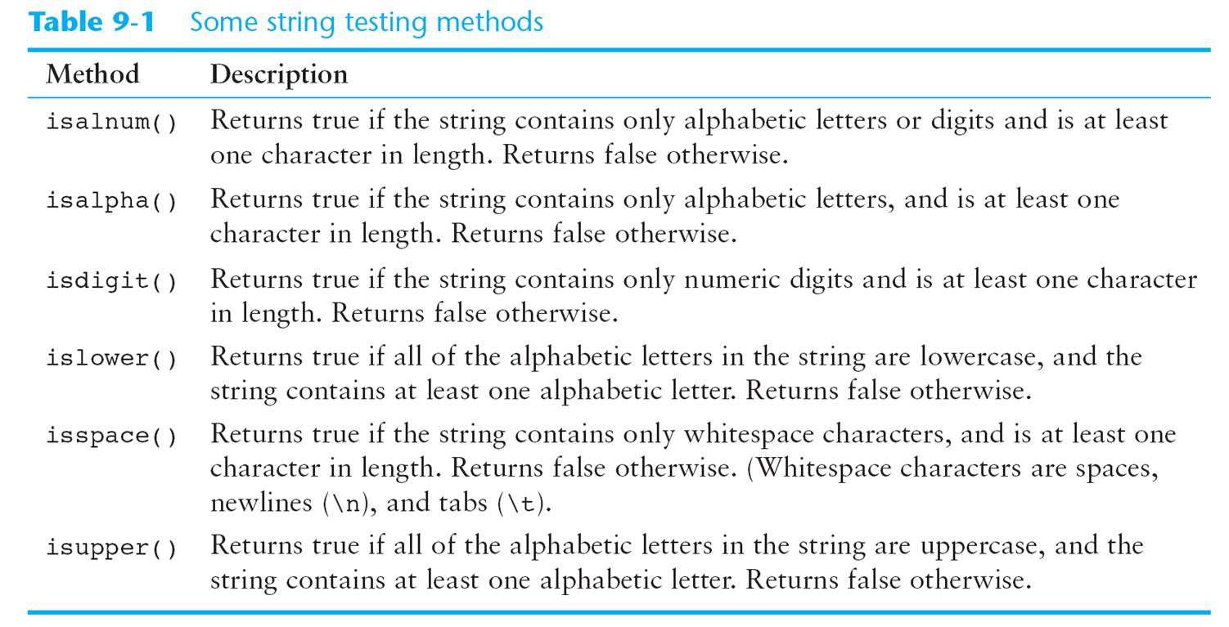

Slide 15
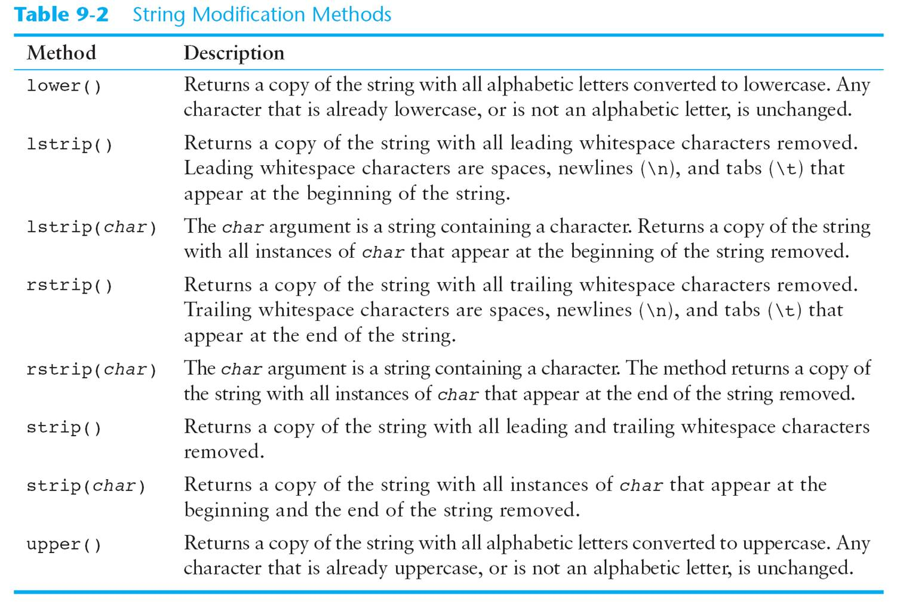

Slide 16
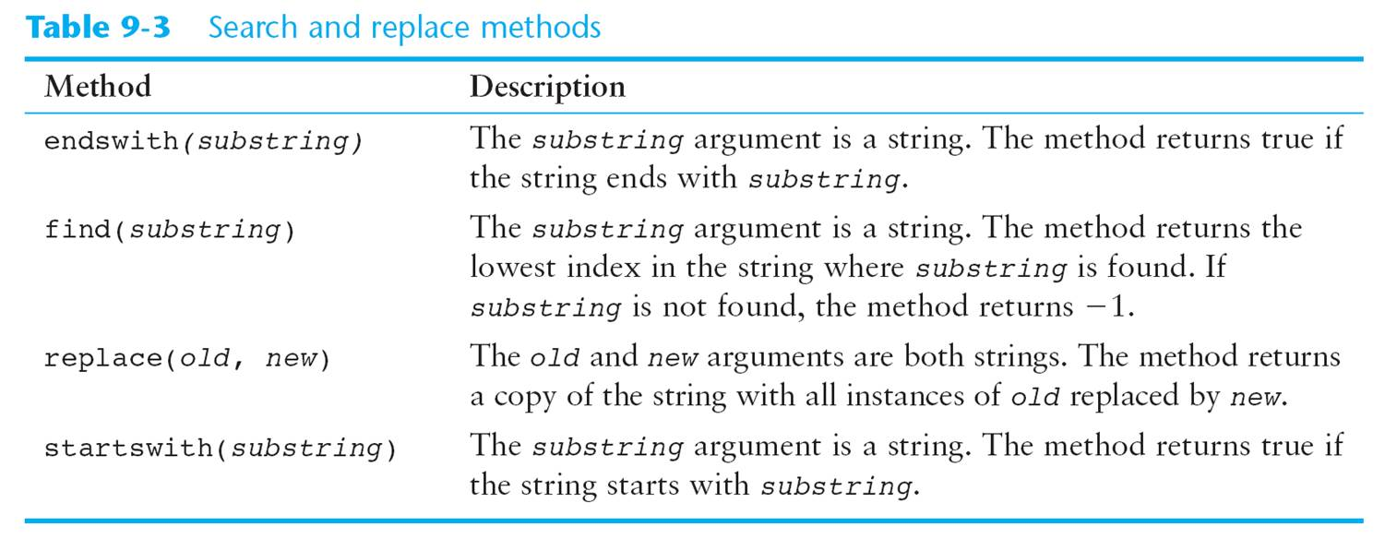

Slide 17
Puzzle
Write a function called count_vowels that takes a single string parameter. The function should count the vowels in the string, and print out the number of vowels. (Do not count y as a vowel.)
Modify the function to also output each vowel and its index in the string.

Slide 18
Puzzle (Hard)
Write a function called pluck_word_3 that takes in a single string parameter. The function should pluck out the third word from the string, and print it out. Assume the string has at least three words.
'This is the end.'

